Slide 1
InceptionV1(GoogleNet)
Vignesh

Slide 2
Inception
- Introduced by Google in 2014
- 9 inception modules stacked sequentially, 22 layer deep network, 27 layers deep including pooling layers
- winner at ILSVRC 2014 image classification challenge
- Inception proposes ‘Wider Network Rather Than Deeper Network’
- Reference paper : Going Deeper With Convolutions

Slide 3
Why Inception?
- While performing convolutions it is important to decide what size of filter to use at each layer, but there is no specific method to do this
- Instead of manually deciding what filters to use inception architecture allows to use multiple convolution filters of different size at same level and lets network decide itself the optimal configuration
- In Inception architecture filter sizes are restricted to:
1 x 1
3 x 3
5 x 5
- Inception makes use of 1x1 convolutions which are used specifically for dimensionality reduction (results in less parameters which leads to reduction in computational resources)

Slide 4
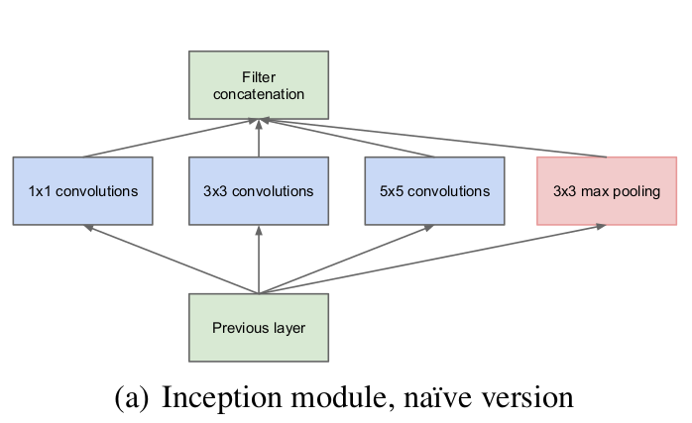
Why different filter sizes?
Generally the area obtained by each object in an image is different.
For example.,
In some image there may be a zoomed in dog image where most parts of the image contain dog information whereas in other case the dog may only cover a little part of the image and most part is covered by background which is unnecessary.
Because of huge variation in location of information choosing the right kernel size for extracting feautres via convolution is difficult.
- smaller kernel size – smaller information
- larger kernel size – larger information

Slide 5
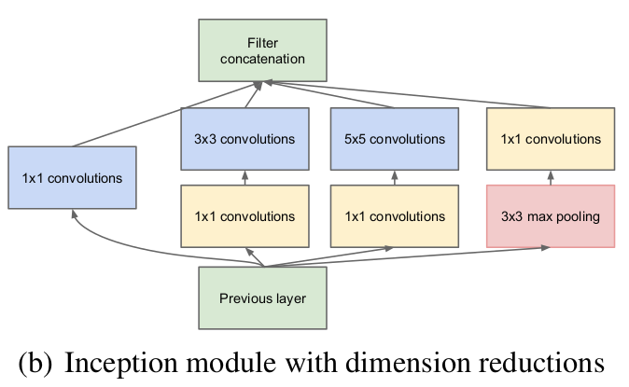
- Deep neural networks are computationally expensive
- To reduce the computation, but without loss of information authors introduced the use of 1x1 convolutions before 3x3 and 5x5 convolutions

Slide 6
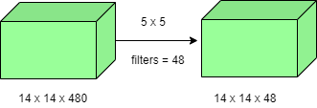
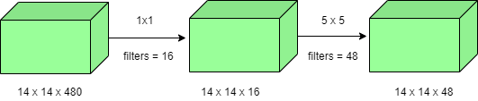
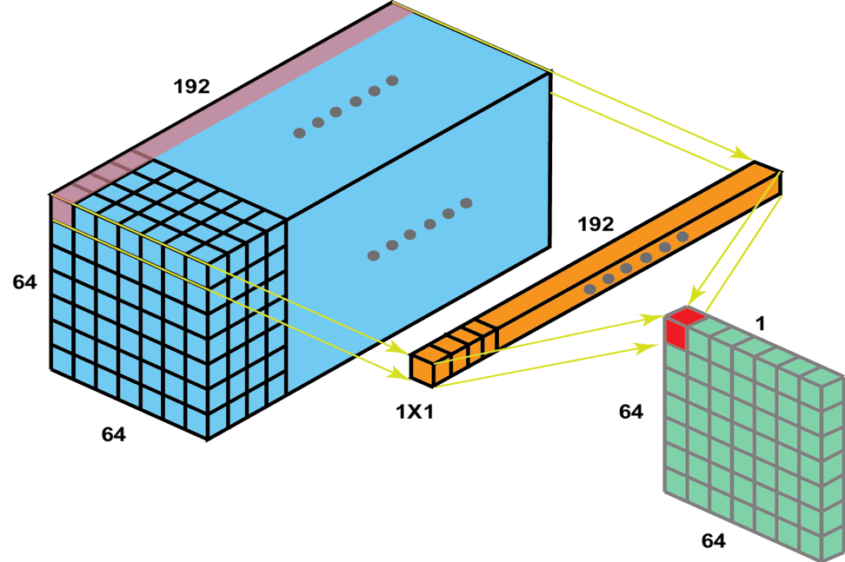
Why 1x1 convolution?
Standard convolution :
- (14x14x48) + (5x5x480) = 112.9M
1x1 convolution :
- 14x14x16 + 1x1x480 = 1.5M
- 14x14x48 + 5x5x16 = 3.8M
- Total params = 1.5M + 3.8M = 5.3M
Using 1x1 convolutions has resulted in decreasing the number of parameters by a large count.
Also called as feature map pooling or projection layer

Slide 7
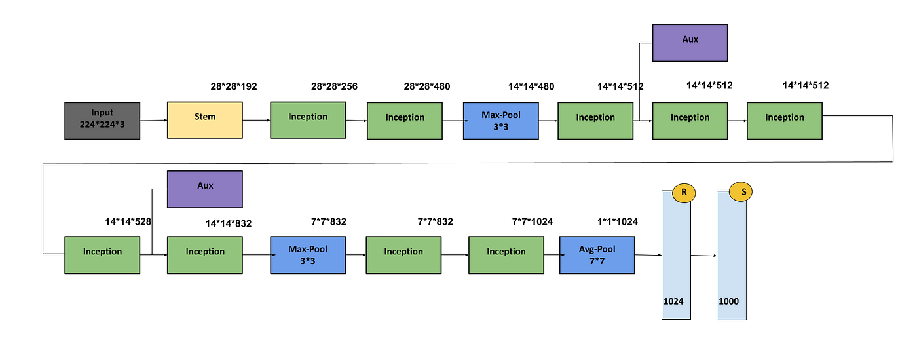
InceptionV1 architecture

Slide 8
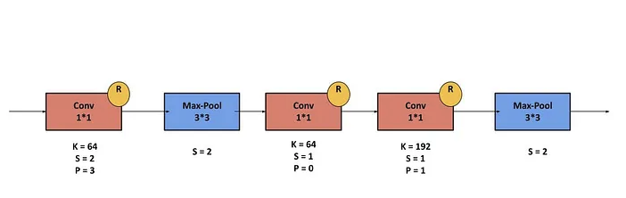
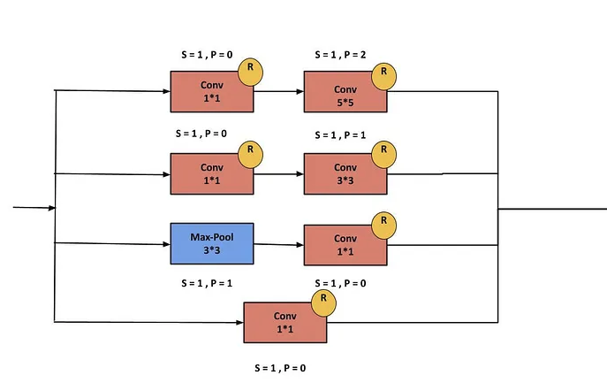
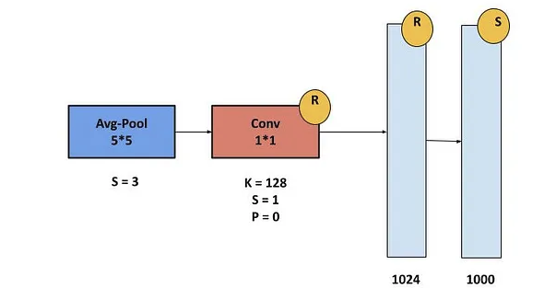
InceptionV1 blocks
Stem
Aux
Inception

Slide 9
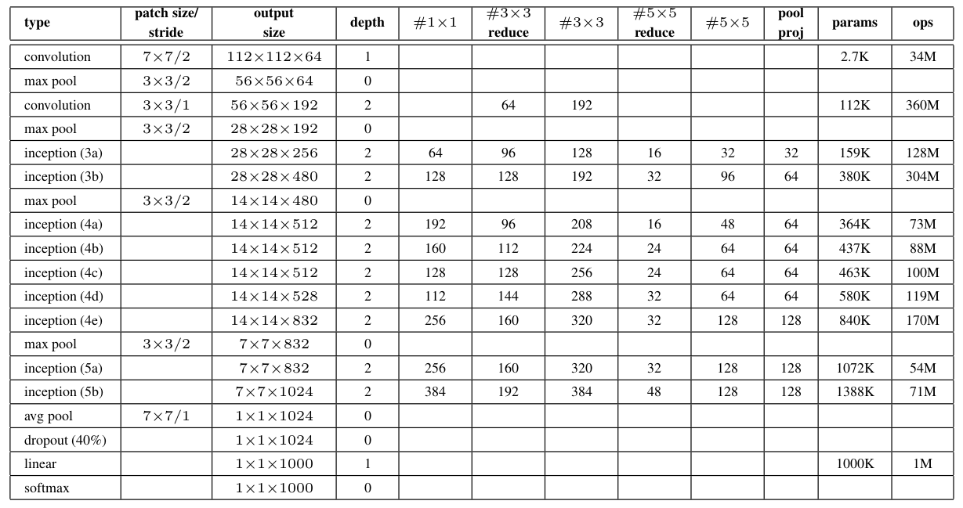
InceptionV1 architecture

Slide 10
Problems of InceptionV1 architecture
Inception V1 have sometimes use convolutions such as 5*5 that causes the input dimensions to decrease by a large margin. This causes the neural network to uses some accuracy decrease. The reason behind that the neural network is susceptible to information loss if the input dimension decreases too drastically.
Furthermore, there is also a complexity decrease when we use bigger convolutions like 5×5 as compared to 3×3. We can go further in terms of factorization i.e. that we can divide a 3×3 convolution into an asymmetric convolution of 1×3 then followed by a 3×1 convolution. This is equivalent to sliding a two-layer network with the same receptive field as in a 3×3 convolution but 33% cheaper than 3×3. This factorization does not work well for early layers when input dimensions are big but only when the input size mxm (m is between 12 and 20). According to the Inception V1 architecture, the auxiliary classifier improves the convergence of the network. They argue that it can help reduce the effect of the vanishing gradient problem in the deep networks by pushing the useful gradient to earlier layers (to reduce the loss). But, the authors of this paper found that this classifier didn’t improve the convergence very much early in the training.

Slide 11
References
- Network In Network
- Understanding 1x1 convolutions
- A Gentle Introduction to 1×1 Convolutions to Manage Model Complexity
- Going Deeper with Convolutions
- GoogLeNet CNN Architecture Explained (Inception V1) with code
- Talented Mr. 1X1: Comprehensive look at 1X1 Convolution in Deep Learning
- Introduction to InceptionNet Scaler
- Review of Inception from V1 to V4
- Inception-V1 (GoogLeNet): Summary and Implementation

